Slide 1
Covidome
Group 18
P.Samarasinghe
K.A.G.D.Maheekumara
K.K.D.R.P.Kannangara

Slide 2
Problem Eventhough the best way to stay away from covid 19 is staying at home in order to satisfy our basic needs and wants we have to interact with people. So is there any way to identify High Covid risky areas? Solution Using this application we can track the location of a person and sending a notification to the user if he enters or leaves a covid red zone (Location with high density of covid patients). Which will help to avoid covid spread to a certain extent.

Slide 3
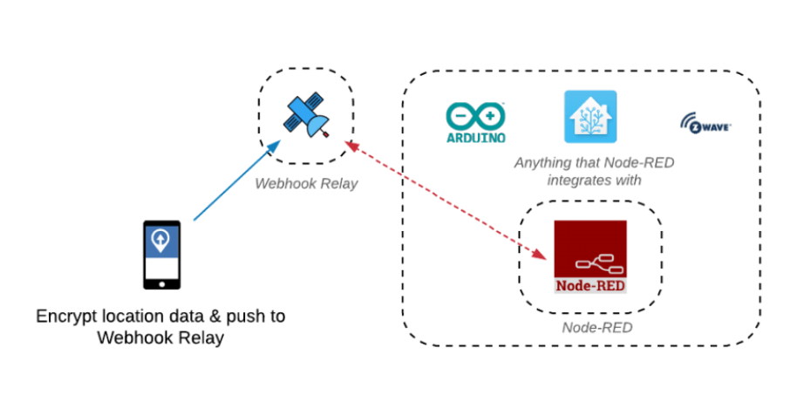
System overview and operation Interconnection between node red and Mobile application We use a mobile phone application called owntracks which provides the the location of the user. Our location data will be relayed to Node red through a public webhook relay address. Why webhooks? Webhook Relay provides public endpoints which can accept webhooks and then, based on user defined rules, forward them to either public or internal destinations.

Slide 4
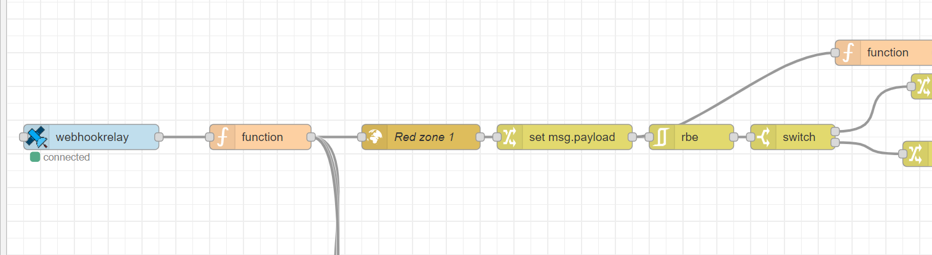
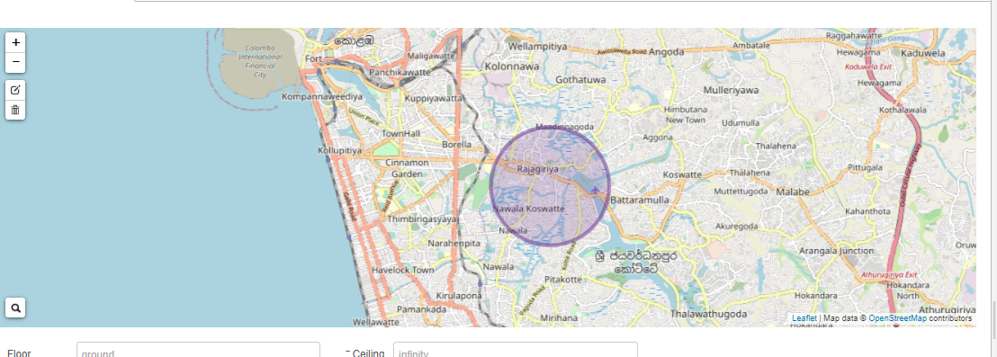
Node Red operation

Slide 5
Node Red to Node MCU Flow chart
NODE RED
MQTT Brocker
NodeMCU
We send a message from NODE Red to node mcu using MQTT client.
MQTT has very small clients.
So we can use minimal resources such as small microcontrollers.
It has a very small message head so we can reduce network bandwidth.
Also low power is required.
NODE RED – sever.
ESP 8266 – client.
NODE RED publish topic location and the ESP which act as the client subscribe to this topic.

Slide 6
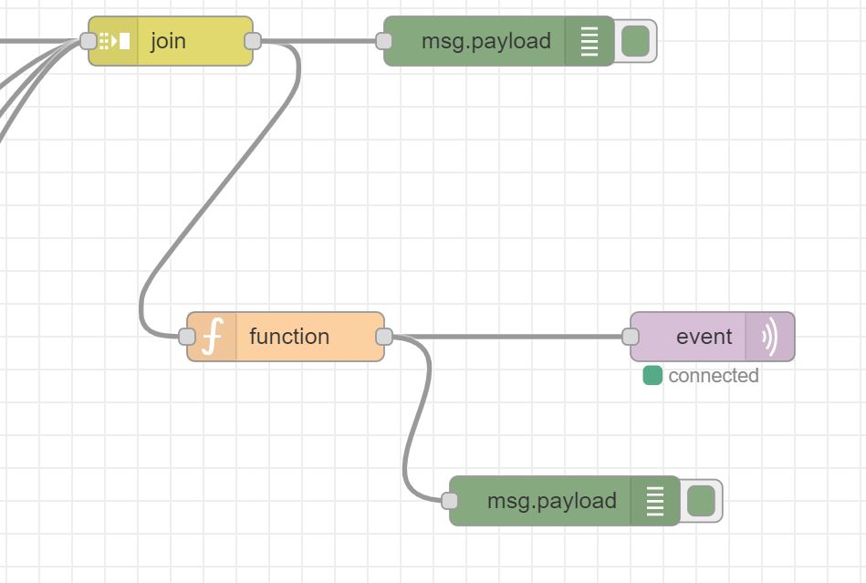
Node Red operation

Slide 7
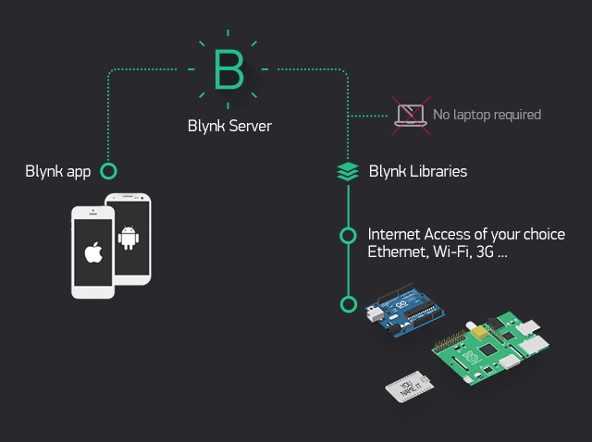
NodeMCU to Mobile Phone
For this task , we use BLYNK app.

Slide 8
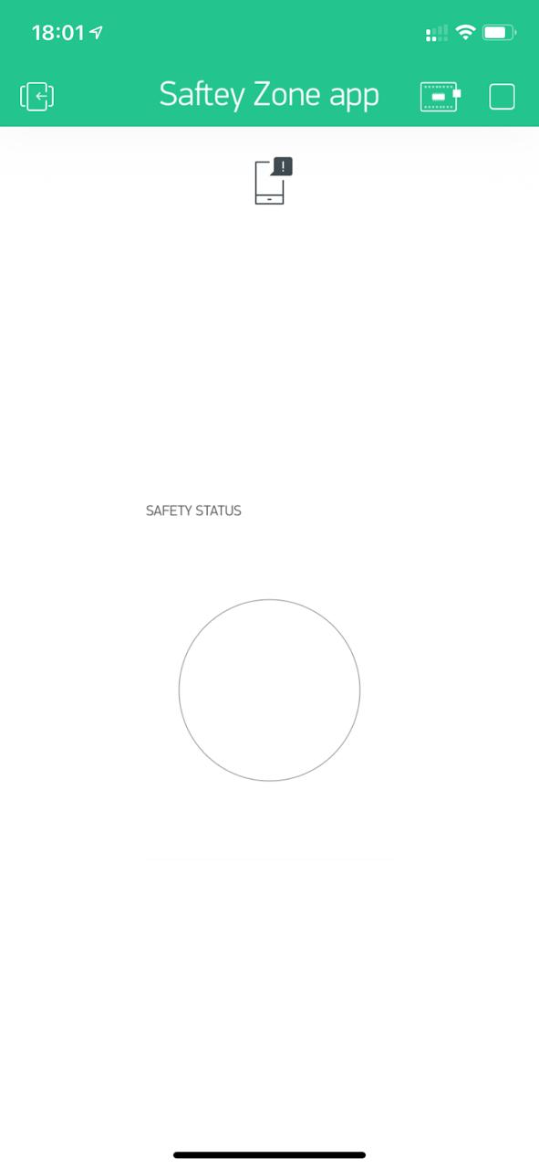
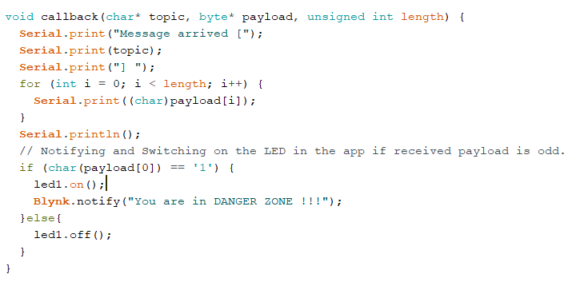
The mobile app looks like this when the person is in the safe zone.
In the NodeMCU , We analyze the received payload.

Slide 9
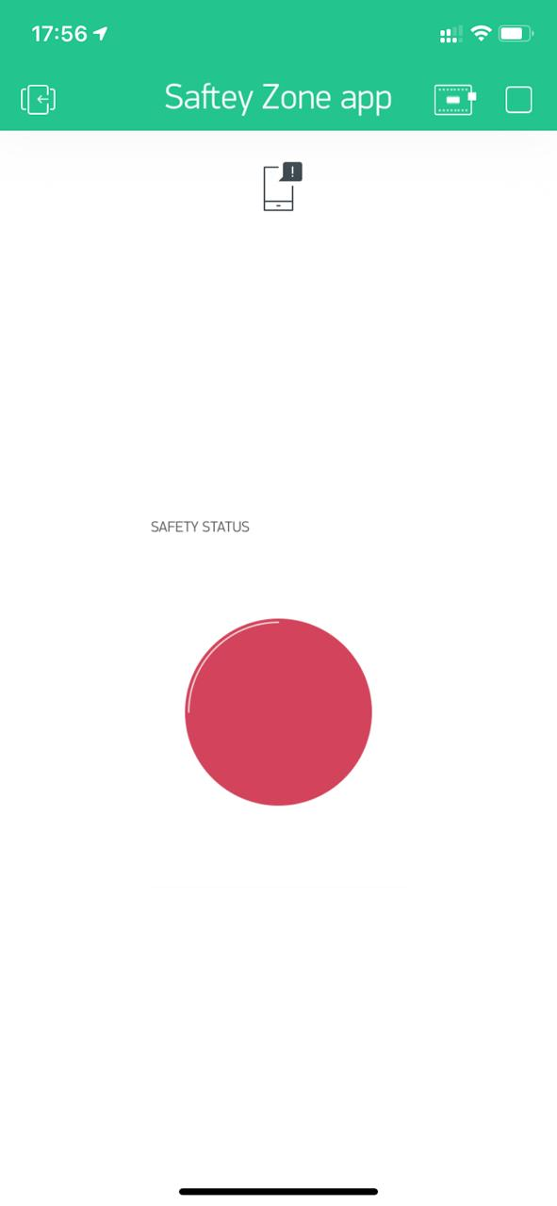
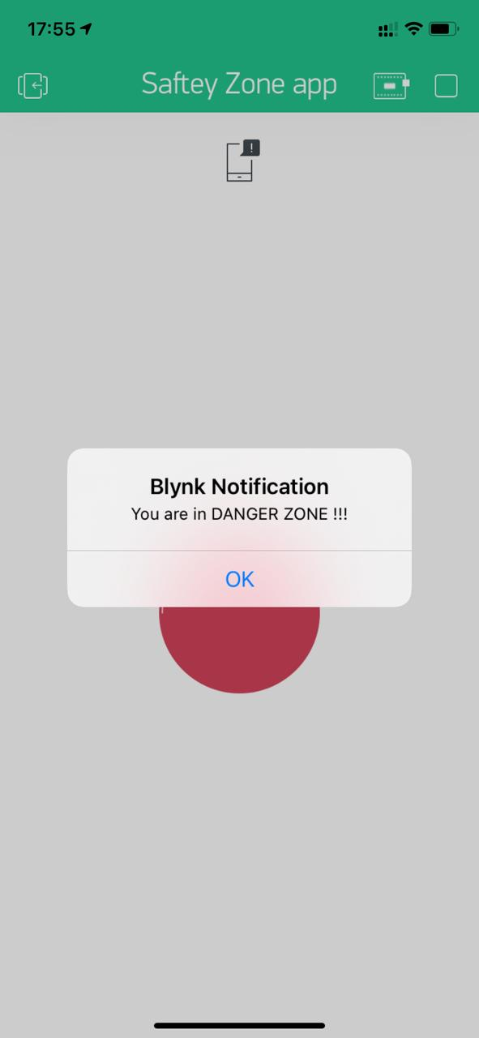
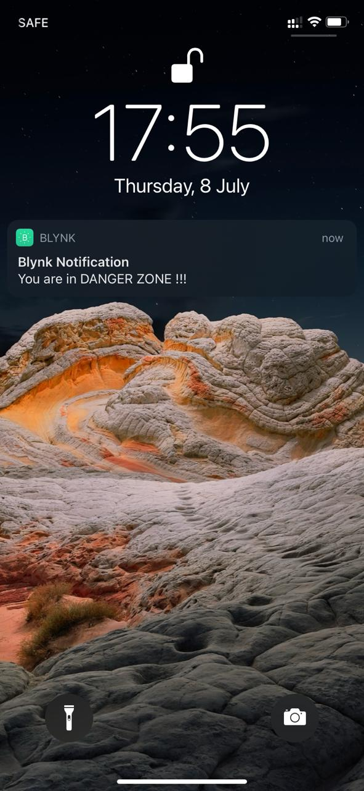
When the person enters a covid affected zone , the app will notify you.
(A) (B) (C)

Slide 10
THANK YOU !

